Slide 1
Git Filters vs. Git Hooks
Marco A. Garcia

Slide 2
Background
Git works its magic in the background through the use of git objects
There are four types of git objects
Blobs: The binary data of a file packaged with the size of that data and a label indicating the object type (i.e. blob)
Trees: A series of cache entries that describe the file mode (permissions), file name, and SHA-1 hash for a set of blobs.
Commits: Connects a tree to an author, committer, datetime information, commit message, and commit parents (effectively creating a snapshot of your project at the time of the commit’s creation).
Annotated Tags: Connects a commit with the taggers name and email, datetime information of the tags creation, and a tagging message (can also be signed and verified with GPG).

Slide 3
Background
When you have a git repository on your computer, that repository is made up of three things:
The repository itself, which lives in the .git folder. This contains the entire change history of your project and is where the git objects are stored.
The working directory, which is what you generally actually interact with. This is created whenever you checkout a branch from your repository. You are able to add new files to, delete files from, or make changes to files in your working directory.
The staging area, which is housed in the index file in the .git folder. This area acts as the liaison between your repository and your working directory. The staging area and your working directory generally contain the same files since the contents of your working directory are passed to the staging area (as a blob) when you use commands like git status. When determining if files have been modified, added, or removed, git compares the repository to the staging area, not your working directory. When you make a change to a file, the file must first move from your working directory to the staging area and must be marked as ready to commit in your staging area (this is done with a “git add filename”) before it can be committed to your repository.

Slide 4
What is a git filter?
A filter is a driver that lives in your local, global, or system config file
It can either be a set of single line commands (like sed) or it can call another script to perform the filtering, but it must operate through standard input/standard output
A filter is composed of a smudge command that runs when a file is checked out and a clean command that runs when a file is checked back in
The basic steps of using a filter are outlined below
Git determines if a smudge or a clean command needs to be run based on if a file is being checked out or checked in
Git feeds the filter a file in the form of a blob through the filter’s standard input
The filter modifies the file, collects information from the file, etc. via the blob sent to it (i.e. does not touch anything in the actual directory)
The filter passes the file with any modifications it made to it via a blob in its standard output
Git receives the filters output and moves it to either the worktree or staging area depending on if a smudge or clean command was run
More information about filters can be found here: https://git-scm.com/docs/gitattributes and https://git-scm.com/book/en/v2/Customizing-Git-Git-Attributes

Slide 5
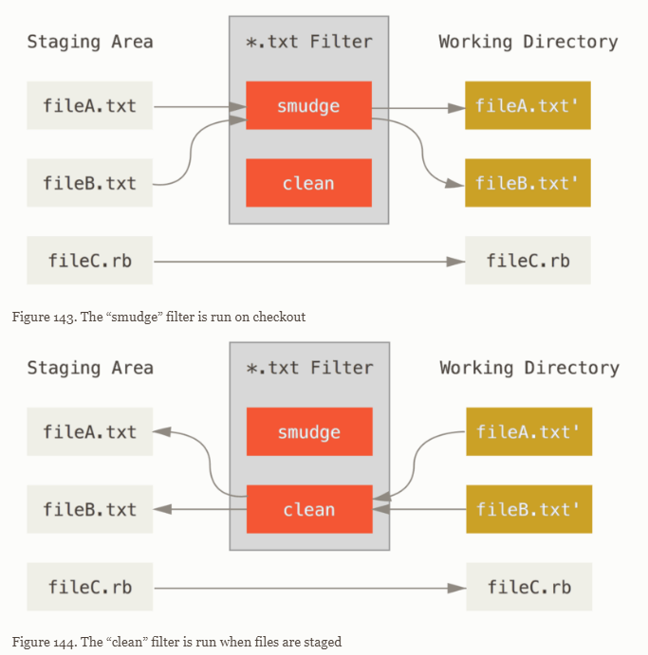
How do git filters work?
Filters operate as an intermediary between your staging area and your working directory
If a file meets the requirements to be passed through a filter, then it goes through the filter every time you either checkout/checkin a file from/to your staging area
Since relevant file will always run through the filter between your working directory and staging area, it allows you to automate changes to files that are needed in the working directory, but that shouldn’t be committed
Any changes made through a filter are not shown as unstaged changes
https://git-scm.com/book/en/v2/Customizing-Git-Git-Attributes

Slide 6
What is a git hook?
A git hooks is a script git runs before or after an action
The following are all the non-server hooks supported by git at this time:
For git to acknowledge a script as a non-server hook, it MUST have one of the names above
More information about git hooks can be found here: https://git-scm.com/docs/githooks and https://git-scm.com/book/en/v2/Customizing-Git-Git-Hooks
- applypath-msg | - pre-rebase | - sendemail-validate
- pre-applypatch | - post-checkout | - fsmonitor-watchman
- post-applypatch | - post-merge | - p4-changelist
- pre-commit | - per-push | - p4-prepare-changelist
- pre-merge-commit | - post-rewrite | - p4-post-changelist
- prepare-commit-msg | - reference-transaction | - p4-pre-submit
- commit-msg | - push-to-checkout | - post-index-change
- post-commit | - pre-auto-gc

Slide 7
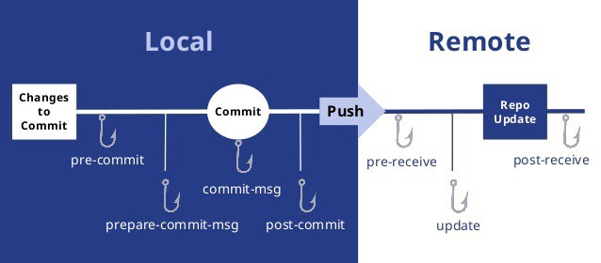
How do git hooks work?
How git hooks function is very simple:
Git calls the hook based on its name
The hook script run
While how git handles hooks is simple, the hooks themselves can be very versatile
A hook can do anything you’d be able to do with a script including interacting with your terminal and changing files and folders in your repo
https://miro.medium.com/max/1104/1*0gycDaNgUuKFQueZoMgesQ.jpeg

Slide 8
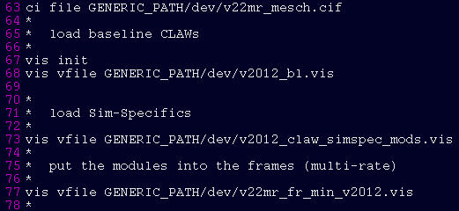
Example Scenario
The runfile repo has several file paths that need to reference the location of the local version of the repo
Since they are hard coded and MASS can’t interpret shell environment variables, a method was needed to modify the necessary file paths for every local repo, but that wouldn’t lead to those modifications being uploaded to the remote repo
After discussion, it was decided that this could be done with either a filter or a set of hooks

Slide 9
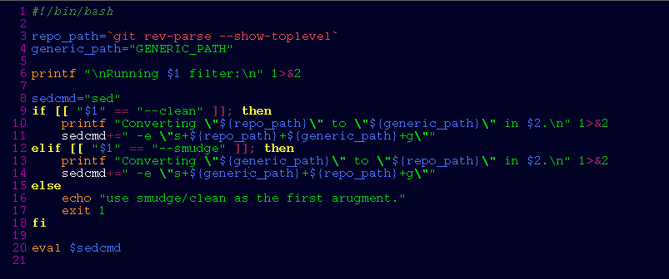
How does the example filter work?
Our filter uses the bash script below to modify file paths in the files fed to it from a generic path name to the local git repo location or vice versa
For a smudge, this script determines the repo location, performs a sed command on the file git passes to it from your staging area to change “GENERIC_PATH” to the repo location, and outputs the resulting file to your working tree
For a clean, this script determines the repo location, performs a sed command on the file git passes to it from your working tree to change the repo location to “GENERIC_PATH”, and outputs the resulting file to your staging area

Slide 10

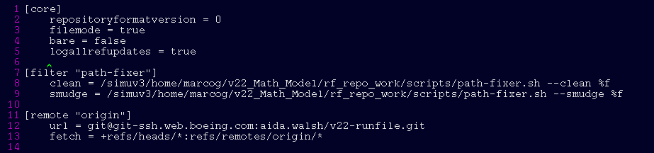
How does the example filter work?
Git decides what files are passed through the filter by rules outlined in the .gitattributes file
Our .gitattributes file lives in the root directory of our repo and can be seen below
It specifies that any file with the run, vis, or cif extension must be passed through the path-fixer filter
A filter needs to be added to the local git config file before git knows that it should be run; an example of our filter added to a local git config file is below:

Slide 11
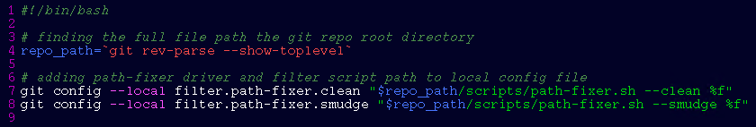
Example Filter Setup
The filter script lives in the scripts folder of the repo and the .gitattributes file lives in the repo’s root directory, so once incorporated they can be managed like any other file in the repo
Since the config file cannot be managed by the repository, users will have to setup the filter by modifying their config file right after they clone the repository
The filter can be setup in local config file using the following two commands:
Alternatively, a setup bash script can be created that would perform all necessary setup commands for a repo and would only have to be run by the user once immediately after cloning the repo
git config --local filter.path-fixer.smudge “<path to repo>/v22-runfile/scripts/path-fixer.sh --smudge %f”
git config --local filter.path-fixer.clean “<path to repo>/v22-runfile/scripts/path-fixer.sh --clean %f”

Slide 12
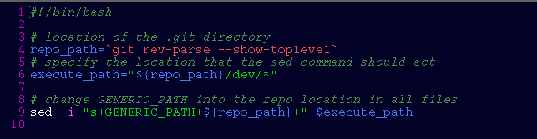
How do the example hooks work?
A post-merge hook is used to modify the file paths of all files in the dev folder from a generic path to the repo location
The post-merge hook applies the sed command to change “GENERIC_PATH” to the repo location indiscriminately to every file in the dev folder after a merge has taken place
A merge takes place whenever a pull command or, depending on the case, a checkout command is used, so this hook will affect any incoming file
Since the hook is actively changing the files in your worktree, any file that is affected by the hook will show up as having unstaged changes when a status command is used

Slide 13
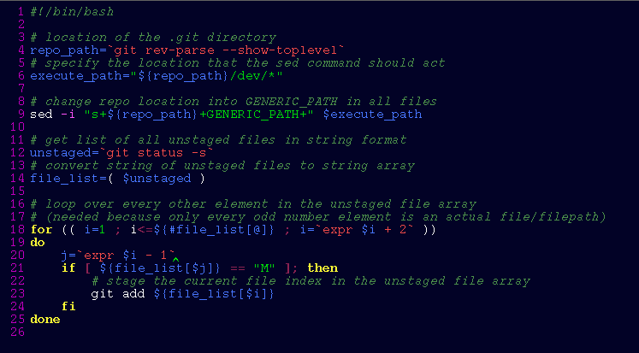
How do the example hooks work?
Since we don’t want any of the changes made in the post-merge hook to appear in any of our commits and be pushed to remote, we use a pre-commit hook to modify the file paths of all files in the dev folder from the repo location back to a generic path

Slide 14
How do the example hooks work?
Since the pre-commit hook is making changes to the actual files in the repo, any files that are changed have to be staged to be included in a commit
At the moment, our pre-commit hook stages any files it has changed by staging any file with the modified tag in the list of all unstaged files after the sed command
A consequence of the current pre-commit hook script is that, since all the unstaged files with the modified tag are staged, some changes not intend or desire to be commit could be inadvertently be included in the commit triggering it
Once a commit has been saved, the post-commit hook modifies all the file paths of all the files in the dev folder from the generic path to the repo location
The post-commit hook shares the same consequences as the post-merge hook as they are identical

Slide 15
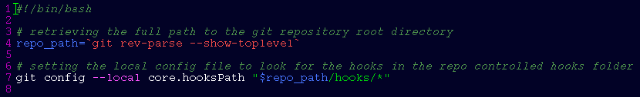
Example Hook Setup
The git hooks live in the hooks folder of the repo, so once incorporated they are managed like every other file in the repo
Since the hooks are placed outside of the default hook location, git needs to be told where it has to look for the hooks in the local git config file immediately after the repository has been cloned
The hooks can be sourced in the git local git config file using the following command:
Alternatively, a setup bash script can be created that would perform all necessary setup commands for a repo and would only have to be run by the user once immediately after cloning the repo
git config --local core.hooksPath “<path to repo>/v22-runfile/hooks”

Slide 16
Git Filters vs. Git Hooks
Filter | Hooks
PROS
Only modifies a temporary version of the files | Easy to understand
Only modifies one file at a time | Easy to implement
Does not display modifications as unstaged changes | Easy to bugfix
.gitattribute could be used for additional purposes at a later date
CONS
Hard for average user to understand the nuisances | Could commit undesired changes
Hard to implement from scratch due to limited example/documentation | Some users could be confused by the modified files appearing unstaged
Does not apply changes to entire directory

